Slide 1
Creating and Working on your PPT
Do NOT work on the online (web-based) version of PowerPoint!
Download the PPT template (“Final Robotics Projects Template 2019.pptx”) from Canvas and change the name to include:
Short DESCRIPTIVE Title
Your Name(s)
Current Year
Delete This Page
A BAD name
“My Robot Project by Chris.pptx”
A GOOD name
“Robot Test Grader - Chris Odom 2019`.pptx”

Slide 2
Code Notes
When you think your project is complete, check the following:
Your code works and the project works properly
Your code is well-commented with constants and variables that are named appropriately
Any websites or people that helped create the code are referenced (with links!) in the header.
Your code is tidy and neat with proper indentation. (Tidy it up with CTRL+T.)
Delete This Page

Slide 3
More Code Notes
Your header for ALL code files MUST include:
Your header SHOULD also include the following copyright information:
// FileName.ino by YourName(s) on ThisDate
// DescriptionOfProject
/*
Copyright YourName(s) CurrentYear. All Rights Reserved. No part of these contents may be reproduced, copied, modified or adapted, without the prior written consent of the author(s), unless when used for educational and non-profit purposes.
*/
Delete This Page

Slide 4
Title of your project here
Put one or two images here.
You may wish to change the background of this and all other pages.
Names of the team members here.
Year here.

Slide 5
Title of your project here
Write a short description of your project here. You may resize the box and the font, but don’t write too much. Make the project sound exciting. Really sell it. This will be published for the world to see without any editing from your teacher, so proof it well!
This page will be graded on:
Clarity
Completeness
Excitement generated

Slide 6
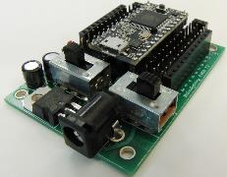
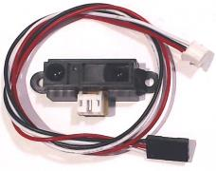
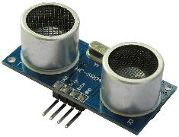
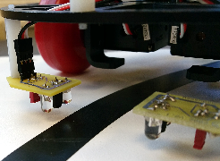
Materials List
[Item.] [Link.] [Cost.] [Image.]
Teensy 3.2 Microcontroller ($19.80) and Patton Robotics Motherboard ($18). https://www.pjrc.com/teensy/teensy31.html and http://pattonrobotics.com/products/patton-robotics-teensy-motherboard-kit.
Sharp Infrared Range Finder (P/N 2YOA21) ($9) from http://pattonrobotics.com/products/sharp-gp2y0a21-ir-infrared-range-sensor-cable. (See image above.)
Sonic Range Finder (P/N HC-SR04) ($3.75) from http://pattonrobotics.com/products/ultrasonic-sensor-and-cables. (See image above.)
Infrared Line-Following Sensors ($2) from http://pattonrobotics.com/products/line-sensors-by-patton-robotics. (See image above.)
Images are very important. It is fine to add additional slides here.
If item is common like IR range finder, line follower, sonic ranger, e.g., then just listing the item is all you need to do.
If the item is unique to your project or is hard to find in general, then give a part number, a link to the item, and perhaps a cost of the item.

Slide 7
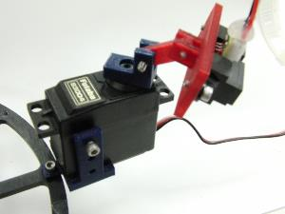
3D-Printed and Laser Cut Parts
Here are images and brief descriptions of ALL the laser-cut and 3D-printed that I used in my project. (These were turned in on the Miscellaneous Files section of the Final Project on Canvas.)
[Object.] [Description.] [Image.]
These may include:
Laser Cutter files (EMS, RLD, and DXF files)
3D Printer files (SKP and STL files)
Images are very important. It is fine to add additional slides here.
If item is common like the sonic ranger mount, then just listing the item is all you need to do.
Submit these via Canvas under “Final Project Misc Files”!

Slide 8
Images of My Project
Put images here.
Make sure the images are in focus, and clearly show how sensors and actuators are attached to the PRT3 Motherboard.
OK to add more pages.

Slide 9
My Code!
Each sketch should have a clear, descriptive file name, easy to follow, and be well-commented.
Here is a list of all INO sketches used in my project with a brief description of each:
[Sketch name.] [Description.]
Submit your code via Canvas under “Final Project Code Files”!

Slide 10
My Project on YouTube (Optional)
Here are some YouTube videos of my project:
For example: The 2012-13 George School Robotics Playlist
For example: Jake’s auto-tracking BB shooter

Slide 11
Improvements, Applications, Suggestions & Advice
What real-world applications are there for your project?
Are there any future additions or alterations that would make your project even better?
Did you encounter any problems that couldn’t be solved? How did you work around them?
What would you have done differently?
You may add more pages

Slide 12
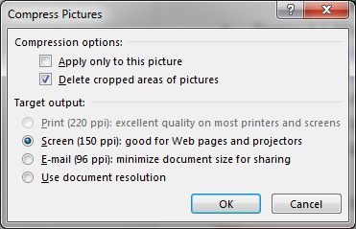
Last-Minute Checks
Before turning in this PowerPoint, you should compress all the images in the document to make the document smaller. Here’s how:
Click on any image in the PPT.
Click on the Format menu under Picture Tools.
Click on “Compress Pictures”.
In the window that opens, uncheck “Apply only to this picture” and select “Screen (150ppi) as shown:
Delete This Page

Slide 13
FINAL NOTES
Before turning in this PowerPoint, check the rubric on Canvas. Did you fulfill all the requirements? If not, fix it or prepare for a lower grade.
The PowerPoint must be uploaded before the end of your Robotics class on the morning of the Open House!
If you are late, there will be a penalty.
If your PPT is not ready by the time of the Open House, you should expect to receive a HUGE penalty!
Once you are sure the PPT is ready to be handed in, turn in your PowerPoint File into Canvas in the usual way.
Next, be sure to turn in ALL your latest Code Files on Canvas.
Each INO file used should be included!
Finally turn in any Miscellaneous Files on Canvas. These include:
Laser Cutter files (EMS, RLD, and DXF files)
3D Printer files (SKP and STL files)
Reference Files (PDF, Word, Excel, etc.)
Videos and extra images.
Delete This Page

